Slide 1
Instant Messenger App
Steps to make it

Slide 2





Front End
Back End

Slide 3
Choosing Terminal
Windows
Windows -> You can use Command Line or Node.js Command Line or Git Bash
or Ubuntu Terminal(Windows subsystem for Linux) or Windows terminal(in that in linux terminal you can customize it with terminal settings,zsh,ohmyzsh,powerlevel10k,zsh-autosuggestion etc. )

Slide 4
Choosing Terminal
Mac OS
Mac OS -> You can use Mac OS terminal or iterm2 (these can be also used with zsh)

Slide 5
Choosing Terminal
Linux
Linux -> You can use Linux Bash (these can be also used with zsh)

Slide 6
Choosing Code Editor
For All Operating System (Windows,Mac OS,Linux)
You can use Microsoft Visual Studio Code or Sublime Text 3 or any other code editor with some react-native plugins or you can use Jetbrains Webstorm IDE for Java Script,Type Script,HTML,CSS,React.js,React DOM,React Native, Redux etc.

Slide 7
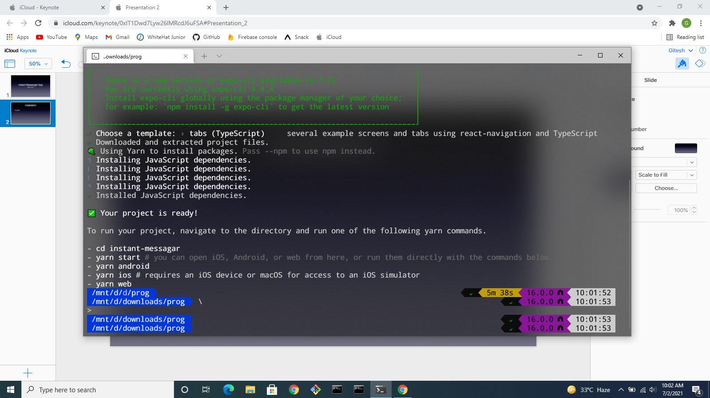
Installation
First Open your Command- Line or Terminal than type expo init instant- messenger (you can install by yarn or npm) and choose tabs with typescript.

Slide 8
Starting With React-Navigation
Open in Navigation Folder index.tsx file and change colors accordingly and title
Tint Color = #0C6157

Slide 9
Icons
Import Octicons and Material Community Icons from @expo/vector-icons
and use them in options in headerRight in view octicons(search) Material Community Icons(vertical-dots) and give styling adjust space and size.

Slide 10
Installation 2
Install by yarn add or npm install @react-navigation/material-top-tabs, react-native-tab-view, react native reanimated

Slide 11
Camera Icon
Import {Fontisto} from @expo/vector-icons and then change component basic things in tabBarIcon and tabBarlabel and set it to null and change size of Icon.

Slide 12
Types
In types.tsx add export types of Message Users and ChatRoom

Slide 13
Data
Make folder data in it make file Chats.ts and ChatRooms.ts.
Chats.ts -> https://github.com/Savinvadim1312/WhatsappClone/blob/main/data/Chats.ts
ChatRooms.ts -> https://github.com/Savinvadim1312/WhatsappClone/blob/main/data/ChatRooms.ts

Slide 14
Make ChatList Of ChatListItem

Slide 15
Installation 3
Run npm install moment or yarn add moment.

